Slide 1


Slide 2

Mini Project (01CE0609)
Semester 6
Review 2 (11/04/2026)
EMAIL SPAM DETECTION USING MACHINE LEARNING
Team ID: T_027
Team Member 1: Yash Talaviya (92410103105) (6EC5)
Team Member 2: Tirth Bhut (92410103093) (6EC5)
Team Member 3: Pratham Gajra (92410103106) (6EC5)
Guided By
Internal Guide
Prof. Yogeshwar Prajapati (Assistant Professor)
Department of Computer Engineering, Faculty of Engineering & Technology

Slide 3
Outline
Abstract
Introduction
How Attack Works
Problem Statement
Literature Review
Dataset Details
Methodology & Flowchart
Tools & Technologies Used
Model Results & Comparison Table
Conclusion
Future Scope
References

Slide 4
Abstract
Email spam is a major cybersecurity issue that leads to phishing attacks, malware distribution, and information theft. This project focuses on detecting spam emails using Machine Learning techniques. The system analyzes email content, subject lines, and metadata to classify emails as spam or legitimate (ham). Text preprocessing techniques such as tokenization, and feature extraction are applied before training ML models. Algorithms like SVM, Random Forest, LinearSVC and LinearSVC + CalibratedClassifierCV are used to achieve accurate classification. The proposed solution helps improve email security by detect malicious emails, thereby protecting users from cyber threats and improving communication efficiency.

Slide 5
Introduction
Email is one of the most common ways people communicate today, but this widespread usage has made it a primary target for cyber threats, including spam, phishing, and malware attacks.
Spam emails consume network resources, reduce productivity, and pose serious security risks by tricking users into revealing sensitive information.
Traditional rule-based systems and keyword filtering are inefficient in handling modern spam techniques because spammers continuously change their strategies (concept drift).
In this project, we move beyond basic models by utilizing advanced text processing (TF-IDF combined with meta-features) and implementing an optimized Linear Support Vector Classifier (LinearSVC) with calibration to accurately classify emails and provide real-time confidence scores

Slide 6
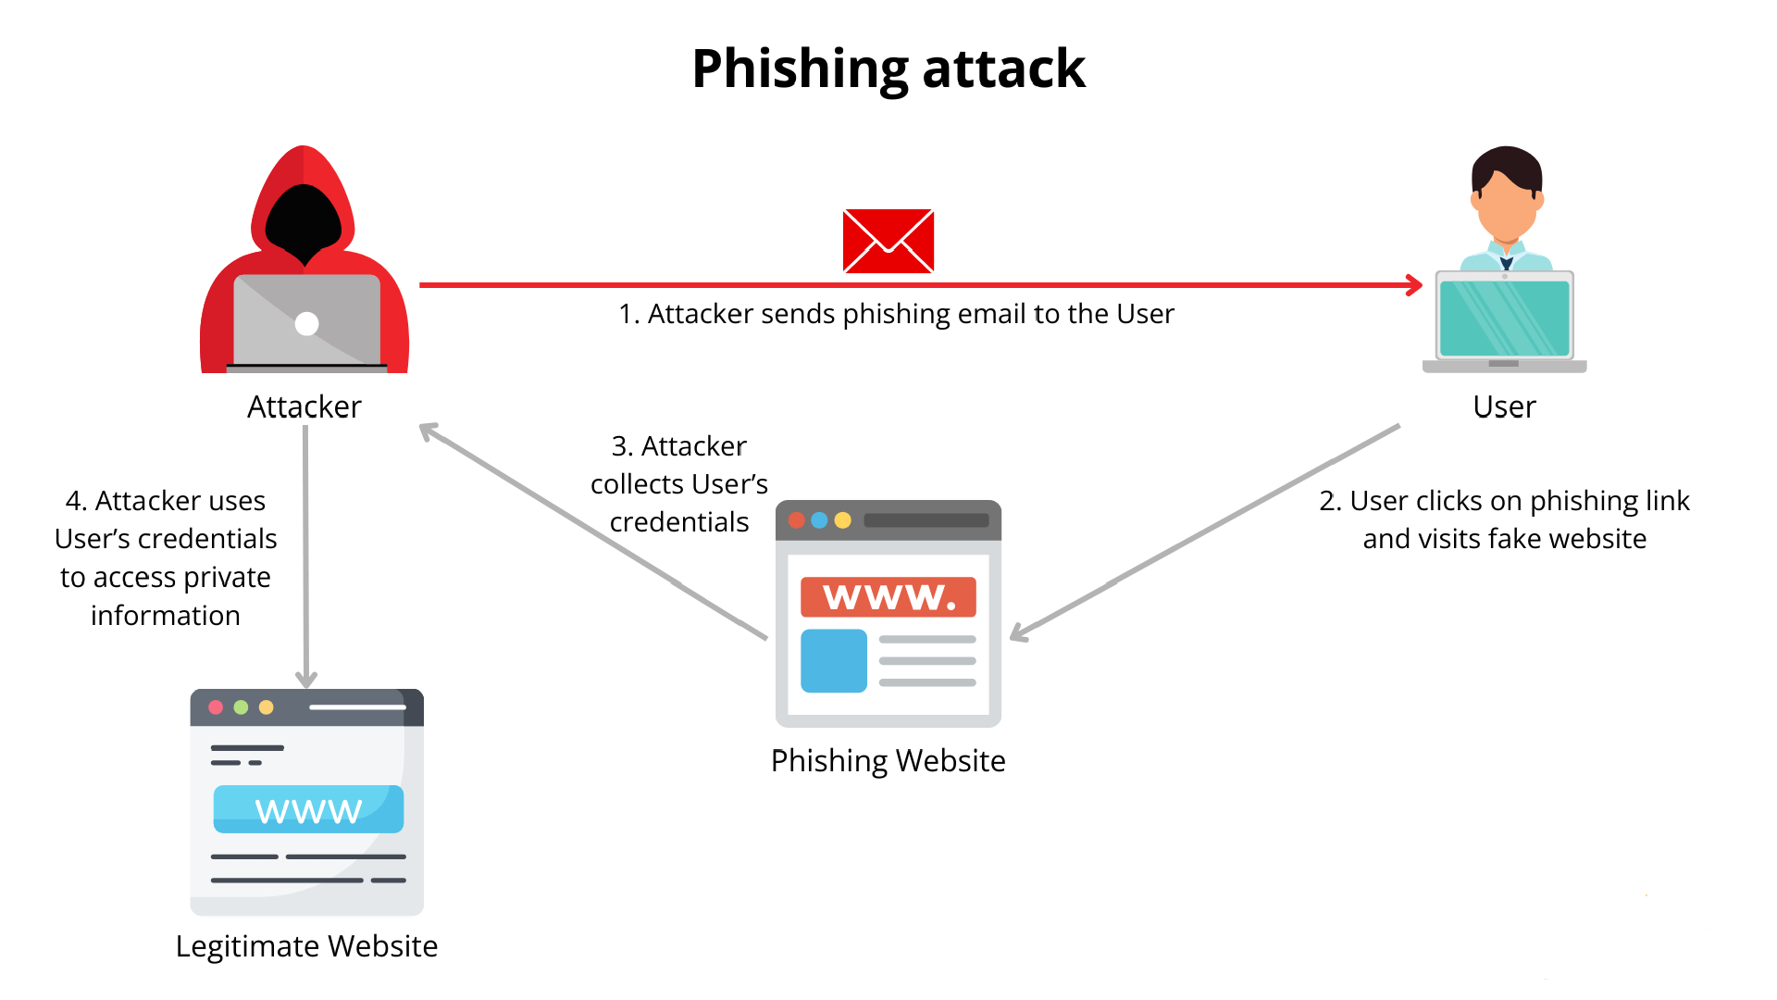
How Attack Works

Slide 7
How Attack Works
The attacker sends a deceptive email that looks like it is from a trusted source, such as your bank, a popular streaming service, or even your workplace. These messages often create a fake mail like claiming your account will be suspended to trick you into acting quickly without thinking.
The user clicks a link in the email and is taken to a fake website designed to look exactly like the real. To the logos, colors, and layout seem perfect, but the address (URL) usually has a slight, hard-to-notice misspelling meant to deceive the visitor.
Believing the site is secure, the user enters their username, password, or other sensitive data. Instead of logging them in, the fake site secretly collects these details and sends them straight to the attacker.
Using the stolen login details, the attacker now has the keys to the user's actual account on the legitimate website. From there, they can easily log in to steal private information, drain funds, make unauthorized purchases, or even steal the user's identity.

Slide 8
Problem Statement
Email is widely used for communication in both personal and professional environments. Along with its benefits, the number of unwanted and spam emails has increased significantly. These spam emails often contain misleading information, advertisements, phishing mails, which can waste users time and create security risks.
Identifying and filtering spam emails is inefficient and unreliable, especially when handling large volumes of emails. Traditional rule-based filtering methods are also limited, as spammers continuously change their techniques to bypass existing filters.
Therefore, there is a need for a system that can accurately classify emails as spam or legitimate. This project addresses this problem by using machine learning techniques to analyze email content and detect spam emails, helping to improve email security and user experience.

Slide 9
Literature Review
Ref. | Methodology | Key Findings | Accuracy | Dataset | Limitations | How to Overcome Limitations
[1] | SMART Framework: Combines Word2Vec, K-means clustering, BERT for semantic enhancement, Multi-objective adversarial training, and Reinforcement Learning (RL). | Traditional static rules struggle with evolving spam. RL and adversarial training allow the model to adapt dynamically to new spammer tactics. | Accuracy: >92%. | References standard datasets like Enron in related work, though specific experimental dataset is not explicitly detailed in snippet. | Traditional methods fail against sophisticated adversarial attacks and lack adaptability. | Proposed Solution: Use reinforcement learning to update detection policies dynamically and adversarial training to robustify against attacks.
[2] | OOAD Methodology: Supervised ML algorithms (Naive Bayes, SVM, Random Forest) with NLP techniques like TF-IDF. | SVM and Random Forest are highly effective. OOAD provides a modular, scalable design. | Accuracy: >94%. | Labeled dataset of 5,572 messages (4,825 Ham, 747 Spam) (Matches SMS Spam Collection stats). | Rule-based approaches are easily evaded. System scalability and maintainability are often overlooked. | Proposed Solution: Integrate Object-Oriented Analysis and Design (OOAD) for modularity and use robust ML models for better accuracy.
[3] | LLM-based: Uses GPT-4 with prompt engineering (Chain-of-thought). Includes email parsing, decoding, and simplification to fit token limits. | LLMs provide detailed reasoning for classifications, increasing user trust. GPT-4 outperforms Llama 2 and PaLM 2. | Accuracy: 93.70% (GPT-4). | Custom Dataset: Collected recent phishing and legitimate emails (as public datasets like Enron are outdated). | LLM token limits restrict input size. Public datasets are outdated. Black-box models lack explainability. | Proposed Solution: HTML/text simplification to manage tokens. Generate detailed rationales for users.

Slide 10
Literature Review
Ref. | Methodology | Key Findings | Accuracy | Dataset | Limitations | How to Overcome Limitations
[4] | Hybrid ML: Count Vectorizer (Bag-of-Words) with Multinomial Naive Bayes. Preprocessing includes stopword removal and stemming. | Lightweight models like Naive Bayes are scalable and effective for real-time deployment. | Strong performance in precision, recall, and accuracy | SMS Spam Collection Dataset (UCI): 5,572 messages (4,825 Ham, 747 Spam). | High false positives in traditional filters. Computational efficiency vs. accuracy trade-off. | Proposed Solution: Use lightweight vectorization (Count Vectorizer) and Naive Bayes for a balance of speed and accuracy.
[5] | Point-Biserial Correlation for feature selection. Algorithms: SVM, ANN, KNN, RF, DT, Logistic Regression. | Feature selection is critical. SVM and ANN outperformed other classifiers. | SVM Accuracy: 91.00%; ANN Accuracy: 92.06%. | UCI Spambase Dataset (approx. 5,000 instances). | Overfitting in complex models (like ANN) with small datasets. Previous studies often lacked rigorous feature selection. | Proposed Solution: Apply Point-Biserial feature selection to reduce dimensionality and use 10-fold cross-validation.
[6] | Review Study: Analyzes ML, Deep Learning (CNN, LSTM, BERT), and Fuzzy Systems. | DL methods are superior but resource-intensive. Hybrid models (e.g., Fuzzy-SVM) show promise. | Cites SVM at ~91% and DL models >92%. | Reviews various datasets including CSDMC2010, Enron, SpamAssassin. | Data imbalance, concept drift (evolving spam), and lack of interpretability in Deep Learning models. | Proposed Solution: Adversarial training , Explainable AI (XAI) , and Hybrid systems.

Slide 11
Literature Review
Ref. | Methodology | Key Findings | Accuracy | Dataset | Limitations | How to Overcome Limitations
[7] | Supervised Learning: Review of Naive Bayes, SVM, RF, NN. Proposed Hybrid Framework (Heuristic + ML). | ML adapts to patterns that static rules miss. Feature engineering is key. | SVM Accuracy: 92.10%; | Mentions SpamAssassin, Enron, Ling-Spam. | Adversarial spam (obfuscation), Data Imbalance, Real-world deployment challenges. | Proposed Solution: Continuous retraining, SMOTE for imbalance, and a hybrid framework with feedback loops.
[8] | Comparative Analysis: SVM, Decision Tree, Naive Bayes using TF-IDF and Bag-of-Words. | SVM is the most effective for complex datasets. Naive Bayes and DT are satisfactory but less robust. | SVM Accuracy: 91.48%. | Kaggle Dataset (matches SMS Spam Collection): 5,572 messages (4,825 Ham, 747 Spam). | Overfitting, scalability issues, and maintenance of models. | Proposed Solution: Combine advanced feature extraction with customized SVM kernels.
[9] | Web Integration: RF, KNN, ANN optimized with GridSearchCV. Integrated into a Django Web App. | Random Forest (RF) achieved the highest accuracy. Real-time integration is feasible. | RF Accuracy: 92.78%; KNN: 93.67%; ANN: 92.11%. | Datasets from Ariyadasa et al. (2021) and UNB (2016). | Previous studies lacked end-user integration. KNN is computationally intensive during testing. | Proposed Solution: Deploy the optimal model (RF) via a user-friendly Django web interface for detection.

Slide 12
Literature Review
Ref. | Methodology | Key Findings | Accuracy | Dataset | Limitations | How to Overcome Limitations
[10] | Evaluated five ML classifiers (NB, LR, SVM, DT, RF) with feature standardisation. Used SHAP for model interpretability. | Random Forest was the best-performing model. SHAP analysis confirmed classification relies on meaningful attributes | Random Forest: 94.57%, SVM: 93.38%, LR: 92.41%. | UCI Spambase dataset (4,601 email instances). | Traditional ML struggles with dynamic modern spam. The study is limited to a single dataset. | Explore hybrid models or deep learning approaches on more diverse, continuously evolving datasets.
[11] | Evaluated NB, LR, Extra Tree, SGD, XGBoost, SVM, RF, and MLP with Count-Vectorizer and TFIDF. Used Grid, Random, and Genetic algorithms (TPOT) for hyperparameter tuning. | Stochastic Gradient Descent (SGD) consistently outperformed other algorithms. | SGD: 96.83% (Ling-Spam), 95.12% (UCI), 94.08% (Custom). | Ling Spam, UCI SMS Spam, and a new Custom Dataset featuring a 25% spam rate. | The method relies purely on text-based attributes and may miss advanced evasion techniques like steganography. | Employ image processing specifically to tackle stenographic emails and leverage deep neural network architectures for complex features.
[12] | Topic-based multi-classification (11 categories) using agglomerative hierarchical clustering. Assessed TF-IDF, BOW, Word2Vec, BERT with SVM, NB, RF, and LR. Used OCR to catch "hidden text". | TF-IDF + LR was fastest and best for English; TF-IDF + NB was best for Spanish. The model successfully thwarted "salting" via OCR techniques. | English: 94.6% Accuracy, 0.953 F1 (TF-IDF+LR). | Two novel datasets: SPEMC-15K-E (English) & SPEMC-15K-S (Spanish) with ~15K emails each from INCIBE. | Datasets are highly imbalanced. Word embeddings performed poorly due to small domain-specific vocabularies. | Train Word2Vec and BERT models on much larger, domain-specific corpora to better capture vocabulary contexts.

Slide 13
Literature Review
Ref. | Methodology | Key Findings | Accuracy | Dataset | Limitations | How to Overcome Limitations
[13] | Systematic review of 15 papers evaluating ML techniques. Proposes a framework using ensemble models trained on datasets balanced by SMOTE and feature selection. | Naive Bayes, Random Forest (RF), and K-Nearest Neighbour (KNN) are the most frequently algorithms. they showed high accuracy rates. | Notes reviewed techniques range from 58% to almost 98% accuracy. | N/A (Review of papers from Google Scholar, IEEE Xplore, etc.). | Existing filters struggle with the sheer volume of multimedia. Models are also heavily impacted by class imbalance. | Utilise ensemble learning alongside data balancing techniques like SMOTE. Develop next-generation models specifically capable of handling large volumes of multimedia data.
[14] | Built an ensemble Stacking model utilising NB, SVM, Decision Tree, and KNN as base learners, with Logistic Regression as the meta-classifier. | The stacking ensemble effectively aggregated weak algorithms to significantly reduce false positive and negative rates. | Ensemble Model achieved 95.8% Accuracy and 95.5% F1-score. | Spambase dataset (George Forman, 1999) with 4601 instances and 58 variables. | The dataset relies on older spam structures from 1999, which may not reflect fast-evolving modern spam. Some base models. | Use modern, continuously updated datasets and implement online learning algorithms to continuously refine ensemble performance.
[15] | Integrated Latent Dirichlet Allocation (LDA) for topic modelling with Machine Learning classifiers (Logistic Regression, Naive Bayes, SVM). | Logistic Regression outperformed other models, handling complex relationships well. | Logistic Regression: 95.56% (F-score 0.986). SVM: 96.11%. NB: 95.15%. | Public Kaggle dataset containing 73,932 English messages (balanced ham/spam). | The dataset only consists of English emails. It also did not explore computational intensity or training costs. | Expand the dataset with multiple languages and varying scenarios. Compare computational intensity scales.

Slide 14
Literature Review
Ref. | Methodology | Key Findings | Accuracy | Dataset | Limitations | How to Overcome Limitations
[16] | Utilised Tokenisation, Bag of Words, and TF-IDF preprocessing. Applied Naïve Bayes, SVM, KNN, Decision Tree, Random Forest, Bagging, and AdaBoost classifiers. | Multinomial Naïve Bayes gave the best outcome for spam detection, while ensemble methods proved useful by using multiple classifiers | RF 0.92, SVM 0.95. | "spam.csv" from Kaggle (5573 lines) and custom text datasets. | The machine misclassifies some tuples due to class-conditional probabilities in Naïve Bayes. | Filter spam based on trusted and verified domain names. Incorporate a larger corpus beyond the basic text body.
[17] | Systematic literature review analysing ML and deep learning models (SVM, NB, NN, RCNN) for phishing and spam email detection. | Recurrent Convolutional Neural Networks (RCNN) provided the highest accuracy in reviewed works. | Highlights RCNN achieving up to 96.85% in the cited literature. | N/A (Review of multiple datasets). | Current filters lack dynamic feature spaces and struggle with rapidly evolving phishing scams. Most operate purely in monolingual environments. | Implement dynamic feature space updating, multilingual spam recognition, and collaborative manual annotation to create highly dimensional datasets.
[18] | Comprehensive survey categorising supervised, unsupervised, and deep learning techniques (CNN, BERT) applied to spam email filtration. | (SVM, NB) are foundational but require labelled data. Deep learning approaches significantly increase detection rates. | Notes: Deep Learning increases accuracy to 97.52%. | N/A (Survey). Discusses Enron, Ling-Spam, and SMS datasets. | Training supervised models on large labelled datasets is time-consuming. Models struggle with evasion techniques like image-based spam. | Investigate unsupervised and reinforcement learning. Utilise advanced deep learning architectures (like BERT) to understand message context better.

Slide 15
Literature Review
Ref. | Methodology | Key Findings | Accuracy | Dataset | Limitations | How to Overcome Limitations
[19] | Tested ten supervised ML algorithms (SVM, KNN, NB, NN, RNN, LR, etc.) and integrated a geolocation module to map spammer IP addresses. | High accuracy achieved. The algorithm successfully outputs IP addresses and geolocation maps, | NN: 95.51% (SpamAssassin). SVM: 96.38% (Enron1). LR: 96.22% | SpamAssassin (2551 ham/501 spam), Enron1 (3228 ham/3219 spam), and Kaggle CSV. | Currently evaluates English language emails exclusively and does not natively detect image-based spam tricks. | Expand the language scope. Incorporate image analysis (histograms, file properties) to detect embedded malicious content.
[20] | Implemented the Opinion Rank algorithm and Latent Dirichlet Allocation (LDA). Compared 11 algorithms, including K-Neighbours (KN), Naive Bayes (NB), Random Forest (RF), and Extra Trees. | KN and NB algorithms emerged with the most impressive Accuracy and Precision. The system also aids digital forensics by browser cookies and caches. | Extra Trees: 97.77%, RF: 97.00%, NB: 95.93% | Raw data from Kaggle (4516 spam, 5169 ham). | Models assume a monolingual environment and struggle to distinguish between new and old tags (handling trust dynamics over time). | Integrate multi-domain trust models and include multiple languages to combat linguistic spam. Study trust dynamics over time.
[21] | Naive Bayes (NB) and Logistic Regression (LR) algorithms combined with text processing (tokenisation, stop word removal). | NB and LR show a trivial difference in performance, though NB performs slightly better on testing data according to their findings. | LR Testing: 94.5%. NB Testing: 94.1%. | Ling spam dataset (1000 emails). | Model behaviour is sometimes unpredictable, and the research is limited to evaluating a few algorithms. | Compare more algorithms and integrate AI/Data Mining to build stronger filter models.

Slide 16
Literature Review
Ref. | Methodology | Key Findings | Accuracy | Dataset | Limitations | How to Overcome Limitations
[22] | Literature review of ML methods (NB, SVM, RF, DT, MLP) optimized with bio-inspired methods like Particle Swarm Optimization Algorithm. | Multinomial Naïve Bayes, combined with Genetic Algorithm, performed the best overall among the reviewed models. | Mentions an immune-inspired model identifying >97% in prior studies. | Reviews seven different email datasets. | Rule-based spam detection requires constant updating, and spammers easily evade filters using random sender addresses. | Utilise evolutionary mechanisms to check email content and implement URL verification, models.
[23] | Developed an ensemble model combining Decision Tree (DT), Support Vector Machine (SVM), and Multilayer Perceptron (MLP) | The ensemble model successfully combined the strengths of the base models, producing more consistent results. | Ensemble Model: 96.86%. Individual models: SVM 96.35% | The Enron dataset contains 3672 ham and 1500 spam emails. | The performance of filtering techniques often depends more heavily on the specific data used rather than the algorithm itself. | Combine the knowledge of multiple models into an ensemble framework to achieve optimal and consistent predictive performance.
[24] | Applied Naive Bayes and Support Vector Machine (SVM) binary classifiers with preprocessing steps, including Tokenisation, Stop Word Removal | Naive Bayes effectively calculates class probabilities based on word frequencies, while SVM effectively finds a hyperplane to differentiate the two classes. | Not explicitly specified (built as a GUI application outputting "Spam" or "Not Spam"). | Kaggle dataset. | Searching for the best algorithm and model configurations manually can be extremely time-consuming. | Use self-learning algorithms that can adapt to new data automatically without being explicitly programmed for future spam techniques.

Slide 17
Literature Review
Ref. | Methodology | Key Findings | Accuracy | Dataset | Limitations | How to Overcome Limitations
[25] | Implemented a Logistic Regression classification model for binary prediction (spam/ham) using Pandas for data understanding. | The logistic regression model effectively predicts the output of categorical variables, and the system can also be paired with tools to find the IP address of an email. | 96.70% on training data, 96.59% on test data. | Kaggle dataset containing 5572 emails (ham and spam). | Existing approaches are often incapable of proper and efficient detection as spammers constantly compose new messages concerning user interests. | Utilise machine learning models like Logistic Regression that adapt immediately and detect new risks automatically.

Slide 18
Dataset Details
1)
Size: 18,650 rows and 3 columns. (Kaggle)
Purpose: Used to train machine learning models to detect phishing/spam emails.
Columns:
Unnamed: Index number for each row.
Email Text: The actual content of the email
Email Type: The label, which is either Safe Email (11,322 emails) or Phishing Email (7,328 emails).

Slide 19
Dataset Details
2)
Size: Over 190,000 rows and 3 columns (Kaggle)
Purpose: Used to train machine learning models to detect phishing/spam emails.
Columns:
Unnamed: Index number for each row.
Email Text: The actual content of the email
Email Type: The label, which is either Safe Email or Phishing Email .

Slide 20
Methodology
Data Cleaning: Handled missing values, encoded labels, converted text to lowercase, removed URLs, special characters, and stopwords.
Feature Extraction (Hybrid Approach): Transformed cleaned text into numerical features using TF-IDF vectorization. Combined TF-IDF features with newly engineered Meta-features (structural features like capital letters and punctuation) using a sparse matrix combination.
Model Selection: Transitioned from basic SVM to an optimized LinearSVC, which is faster and highly efficient for sparse, high-dimensional text datasets.
Calibration: Wrapped the LinearSVC model using CalibratedClassifierCV to create a Fast Hybrid Model capable of providing real-time probability/confidence scores for predictions

Slide 21
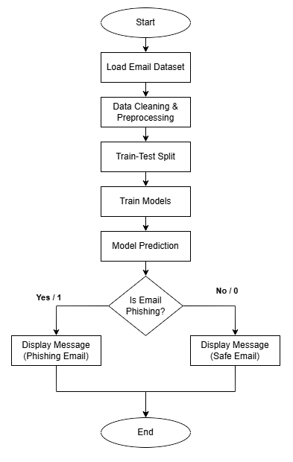
Flow Chart

Slide 22
Tools & Technologies Used
Google Colab – Development and execution environment
Python – Core programming language
Pandas & NumPy – Data preprocessing and manipulation
Scikit-learn – TF-IDF vectorization, SVM, Random Forest, and evaluation metrics
Matplotlib & Seaborn – Visualization of confusion matrix
Support Vector Machine (SVM) – Linear classification model
Random Forest (RF) – Ensemble learning classification model
LinearSVC: Core optimized classification model.
CalibratedClassifierCV: Used alongside LinearSVC to generate probability/confidence scores.
TF-IDF – Text feature extraction technique
Phishing Email Dataset (CSV) – Training and testing data

Slide 23
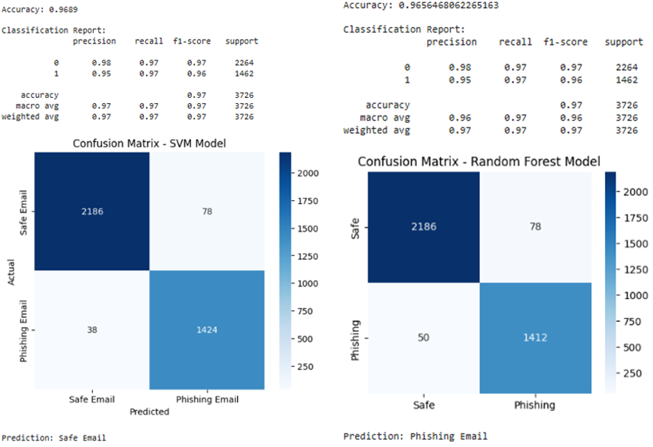
Model Result (SVM, RandomForest)
for Dataset 1

Slide 24
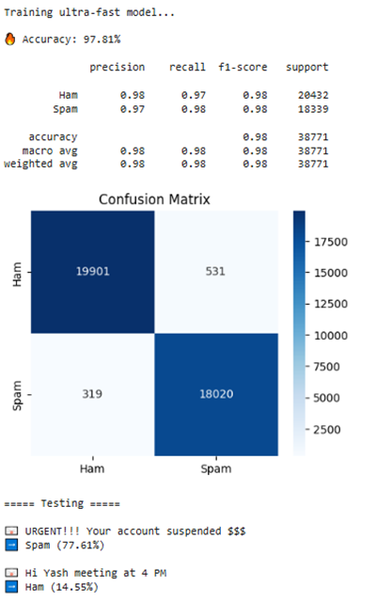
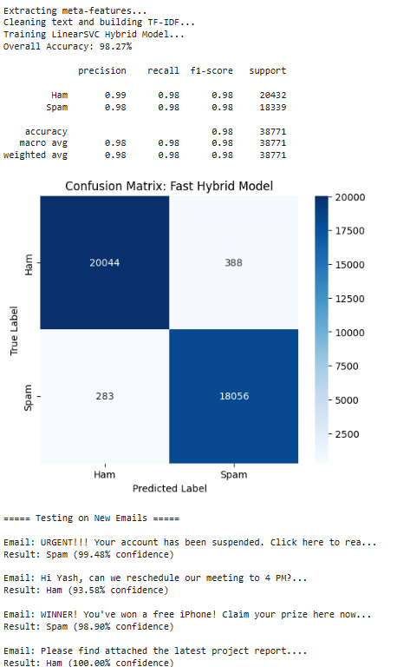
Model Result (LinearSVC, SVC + CalibratedClassifierCV)
for Dataset 2

Slide 25
Model Results & Comparison Table
Model Architecture | Dataset Size | Overall Accuracy | False Positives (FP) | False Negatives (FN)
Linear SVC | Large | 97.81% | 531 | 319
LinearSVC + CalibratedClassifierCV | Large | 98.27% | 388 | 283
SVM | Small | 96.89% | 78 | 38
Random Forest | Small | 96.56% | 78 | 50

Slide 26
Conclusion
The project successfully developed a scalable machine learning pipeline that transitions email filtering from a static rulebook to a dynamic learning model.
By combining TF-IDF, meta-features, and a calibrated LinearSVC, the system achieved a highly impressive accuracy of 98.27%.
Adaptability: The model independently learns semantic patterns, preventing spammers from bypassing it by simply changing keywords.
Generalizability: By training on over 190,000 diverse rows, the model proved its real-world reliability without overfitting to a single data source.

Slide 27
Future Scope
Deep Learning Integration: Implement advanced architectures like BERT to capture deep semantic context and sentence structure for detecting highly personalized spear-phishing attacks.
Adversarial Training: Explore the SMART framework to make the model more robust against sophisticated evasion tactics.
Live Web Integration: Transition the project from an analytical tool to a live, real-time inbox filtering system by wrapping the core Python script into a Web API using frameworks like Flask or FastAPI

Slide 28
References
[1] Taha, Kamal. "Smart: semantic, multi-objective, and reinforcement-based adversarial training for email spam detection." IEEE Access (2025).
[2] I. G. Akawuku, S. O. Adejumo, S. M. Alade, A. A. Olatunde, David, and B. Mulumeoderhwa, "Development of an Efficient Machine learning-based Email spam Detection System," Newport International Journal of Engineering and Physical Sciences, vol. 5, no. 2, pp. 1-10, 2025
[3] Koide, Takashi, et al. "Chatspamdetector: Leveraging large language models for effective phishing email detection." International Conference on Security and Privacy in Communication Systems. Cham: Springer Nature Switzerland, 2024.
[4] Abhinav, Dhara, Ch Bhuvan, and M. Hemanth. "A Hybrid Approach for Email Spam Detection Using Text Vectorization and Machine Learning Models." 2025.
[5] Iqbal, Khalid, and Muhammad Shehrayar Khan. "Email classification analysis using machine learning techniques." Applied Computing and Informatics 21.3-4 (2025): 390-402.

Slide 29
References
[6] Tusher, Ekramul Haque, et al. "Email spam: A comprehensive review of optimize detection methods, challenges, and open research problems." IEEE Access 12 (2024): 143627-143657.
[7] Patil, Aditi, and Priyanka Singh. "Spam Detection Using Machine Learning." IJSAT-International Journal on Science and Technology 16.2 (2025).
[8] M. B. Sakib and S. Mistry, "Email Spam Detection Using Machine Learning: A Comparative Analysis of Classification Algorithms," American International University, Dhaka, 2026.
[9] Onih, V. Adeyemi. "Phishing Detection Using Machine Learning: A Model Development and Integration." International Journal of Scientific and Management Research 7.04 (2024): 27-63.

Slide 30
References
[10] D. Singh, "A Comparative Analysis of Classical Machine Learning Algorithms for Email Spam Detection," International Journal of Computer Techniques (IJCT), vol. 12, no. 6, Nov. 2025.
[11] S. M. Ngigi, J. Karani, R. Mathenge, and N. Muriithi, "Spam Detection in Emails Using Machine Learning Techniques: A Review," International Journal of Computer and Information Technology, vol. 13, no. 3, Sep. 2024.
[12] R. Fatima, M. M. S. Fareed, S. Ullah, G. Ahmad, and S. Mahmood, "An Optimized Approach for Detection and Classification of Spam Email's Using Ensemble Methods," Wireless Personal Communications, vol. 139, pp. 347–373, Nov. 2024.
[13] F. Jáñez-Martino, R. Alaiz-Rodríguez, V. González-Castro, E. Fidalgo, and E. Alegre, "Classifying spam emails using agglomerative hierarchical clustering and a topic-based approach," Information Sciences, 2024.

Slide 31
References
[14] N. Al-shanableh, M. S. Alzyoud, and E. Nashnush, "Enhancing Email Spam Detection Through Ensemble Machine Learning: A Comprehensive Evaluation of Model Integration and Performance," International Information Management Association (IIMA) Conference Proceedings, 2024.
[15] R. Sulthana A, A. Verma, and J. A. K., "A detailed analysis on spam emails and detection using Machine Learning algorithms," Department of Computing and Mathematical Sciences, University of Greenwich, 2023.
[16] G. Borotić, L. Granoša, J. Kovačević, and M. B. Babac, "Effective Spam Detection with Machine Learning," Croatian Regional Development Journal, vol. 4, no. 2, 2023.
[17] A. Felciya I, E. Devi S, M. Maheswari, and S. Roselin Mary, "Email Spam Detection Using Machine Learning Algorithms," (IJARCCE), vol. 12, no. 5, May 2023.

Slide 32
References
[18] S. M. Yasin and I. H. Azmi, "Email Spam Filtering Technique: Challenges and Solutions," Journal of Theoretical and Applied Information Technology, vol. 101, no. 13, Jul. 2023.
[19] P. T. Nallamothu and M. S. Khan, "Machine Learning for SPAM Detection," Asian Journal of Advances in Research, vol. 6, no. 1, pp. 167-179, Mar. 2023.
[20] P. Charanarur, H. Jain, G. S. Rao, D. Samanta, S. S. Sengar, and C. T. Hewage, "Machine-Learning-Based Spam Mail Detector," SN Computer Science, vol. 4, no. 858, Aug. 2023.
[21] I. Moutafis, A. Andreatos, and P. Stefaneas, "Spam Email Detection Using Machine Learning Techniques," Proceedings of the 22nd European Conference on Cyber Warfare and Security (ECCWS), pp. 320-328, 2023.

Slide 33
References
[22] P. Mantri and R. Keole, "A Review on Spam Email Detection using Machine Learning," Journal of Emerging Technologies and Innovative Research (JETIR), vol. 9, no. 4, Apr. 2022.
[23] A. O. Gabriel and A. A. Joy, "An Email Spam Filtering Model Using Ensemble of Machine Learning Techniques," International Journal of Computer Applications Technology and Research, vol. 11, no. 3, pp. 66-71, 2022.
[24] A. Shirwadkar and S. Jacob, "Spam Mail Classifier," International Journal for Research in Applied Science & Engineering Technology (IJRASET), vol. 10, no. 12, Dec. 2022.
[25] C. Abhinav, K. Jayachandra, K. P. Kumar, and V. Sowmya, "Spam Mail Detection using Machine Learning," International Journal for Research in Applied Science & Engineering Technology (IJRASET), vol. 10, no. 6, Jun. 2022.

Slide 34
Q&A

Slide 35


